Slide 1
Understand the Movie Industry
Market Penetration Strategy
Key Success Factors: Budget-Genre-Crew
DN Movie Industry Consulting Firm
Dmitry Mikhaylov & Ngoc Tran
Jun 19, 2019

Slide 2
Three Success Factors for Market Penetration Strategy
Budget
Is it worth it? The industry is booming but:
Production budgets and ticket sales vary significantly
Need to analyse specific budget categories to get actionable insights
Which genres should we focus on?
Genres average ratings, mean vs. variance analysis
Whom should we hire?
Actors, actresses, directors, and writers, each with a “proven track record of success”
Genre
Crew

Slide 3
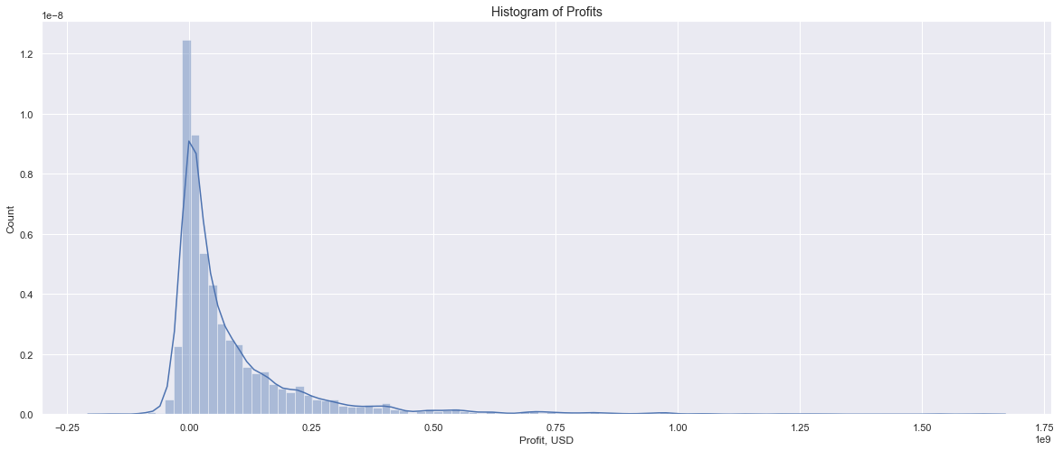
Industry Profitability Analysis
Target this range
Possible losses
It is hard to make a lot of money

Slide 4
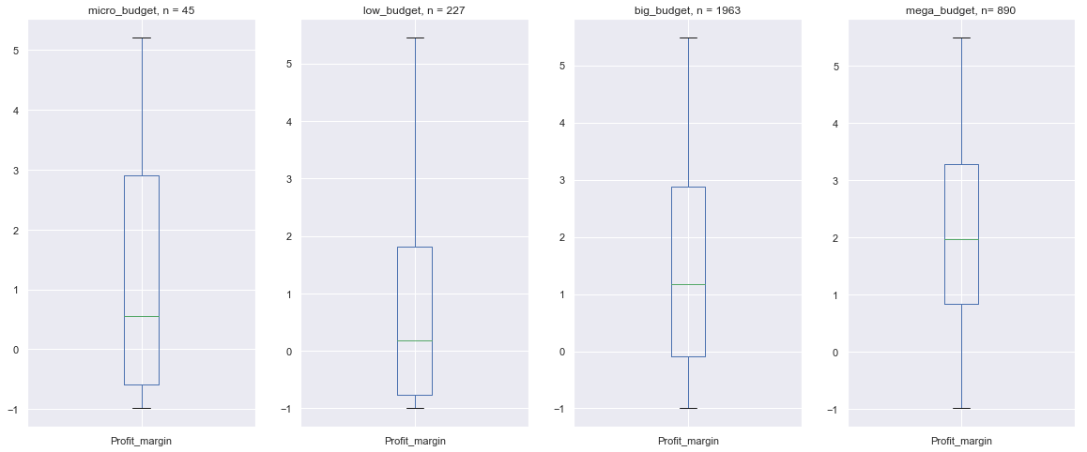
Budget Subgroups
micro: <= 50K
low: 50K - 3M
big: 3M - 50M
mega: > 50M
Budget
Sweet spot
High risk & high reward
Hard to cover overhead
Tends to lose money
Notes:
Number of observations in budget subgroups: 45 micro-budget, 227 low-budget, 1963 big-budget, 890 mega-budget.

Slide 5
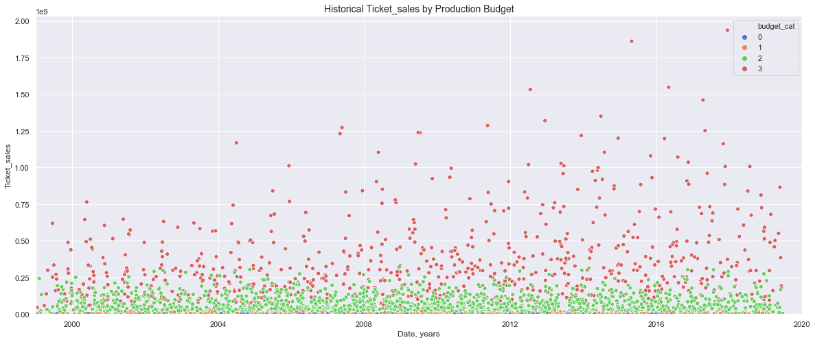
Empirical Map of the Industry
micro: <= 50K
low: 50K - 3M
big: 3M - 50M
mega: > 50M
Budget

Slide 6
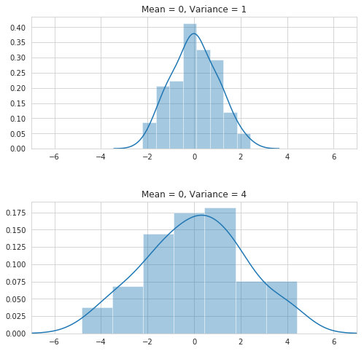
Genres
High mean - low variance average rating categories
Genres
Notes:
The next factor which we think is worth looking into is Genre. On which genres do we want to focus?
Before diving into it, let us steer away for a little bit and talk about variance. What is variance and why is it important?
Variance gives us a general idea of how spread out (or not) our data is. It essentially measures how far each number in the data set is from the mean.
As we can see in these 2 plots, the 2 data sets both have mean 0. However, the top data set with a smaller variance is more clustered while the bottom data set with a larger variance is more spread out.
So why did we talk about it? Well, because our next plot, which has to deal with variance, can help us determine which genres we wanna get ourselves into. This is a plot showing different genres’ average ratings - mean vs. variance, with mean on the x-axis and variance on the y-axis.
Ideally, we want to stay on the top left corner with high mean and low variance because it’s always good to be consistently good. Our high performers are: news, biography, documentary, and history. We want to stay away from this area on the bottom right because it’s hard to draw anything conclusion from them.
We think our findings are interesting because the high performers are those categories that focus on (hopefully) facts and the bad ones are the ones that I, myself, would watch...

Slide 7
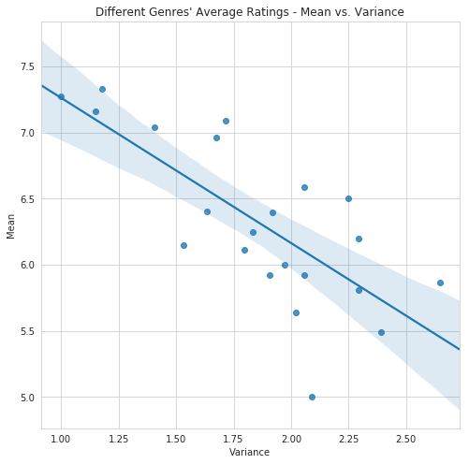
Genres
High mean - low variance average rating categories
Genres
High Performers:
News
Biography
Documentary
Stay Away From:
Horror
Sci-Fi
Western
Action
Thriller
Fantasy
High Mean - Low Variance!
(It’s good to be consistently good.)
Notes:
The next factor which we think is worth looking into is Genre. On which genres do we want to focus?
Before diving into it, let us steer away for a little bit and talk about variance. What is variance and why is it important?
Variance gives us a general idea of how spread out (or not) our data is. It essentially measures how far each number in the data set is from the mean.
As we can see in these 2 plots, the 2 data sets both have mean 0. However, the top data set with a smaller variance is more clustered while the bottom data set with a larger variance is more spread out.
So why did we talk about it? Well, because our next plot, which has to deal with variance, can help us determine which genres we wanna get ourselves into. This is a plot showing different genres’ average ratings - mean vs. variance, with mean on the x-axis and variance on the y-axis.
Ideally, we want to stay on the top left corner with high mean and low variance because it’s always good to be consistently good. Our high performers are: news, biography, documentary, and history. We want to stay away from this area on the bottom right because it’s hard to draw anything conclusion from them.
We think our findings are interesting because the high performers are those categories that focus on (hopefully) facts and the bad ones are the ones that I, myself, would watch...

Slide 8




Movie Crew
At least 5 movies with average ratings of 8 or higher
Crew
Actors | Actresses | Directors | Writers
Timothy J. Cox | Lauren Lopez | Josh Lowell | Nick Rosen
Joshua Bell | Lelani Mitchem | Tim Van Someren | Alvaro Calderón
Ian Cranston | Sargun Mehta | Nick Rosen | Matt Lang
Notes:
Our last factor is Movie Crew.
This is not a complete list of good actors, actresses, directors, and writers and by no means saying that we should hire them at the same time or that the first mentioned person is the best of his or her list.
Each of these people has a “proven track record of success.” Each person here has participated in at least 5 movies with average ratings of 8 or higher.

Slide 9
Conclusion
Budget
Choose big-budget movies; avoidance of micro-, small-, and mega-budgets, focused approach and budgetary controls
Consider high mean - low variance average rating categories: News, Biography, and Documentary genres
Hire successful people based on strict selection criteria: at least 5 movies with average ratings of 8 or higher
Genre
Crew

Slide 10
Credits
Movie budgets analysis:
TheMovieDB.org (https://www.the-numbers.com/movie/budgets/all)
tn.movie_budgets.csv.gz
Genres analysis:
IMDB (https://www.imdb.com/interfaces/)
imdb.title.basics.csv.gz
imdb.title.ratings.csv.gz
Crew analysis:
IMDB (https://www.imdb.com/interfaces/)
imdb.title.principals.csv.gz
imdb.title.ratings.csv.gz
imdb.name.basics.csv.gz

